Slide 1
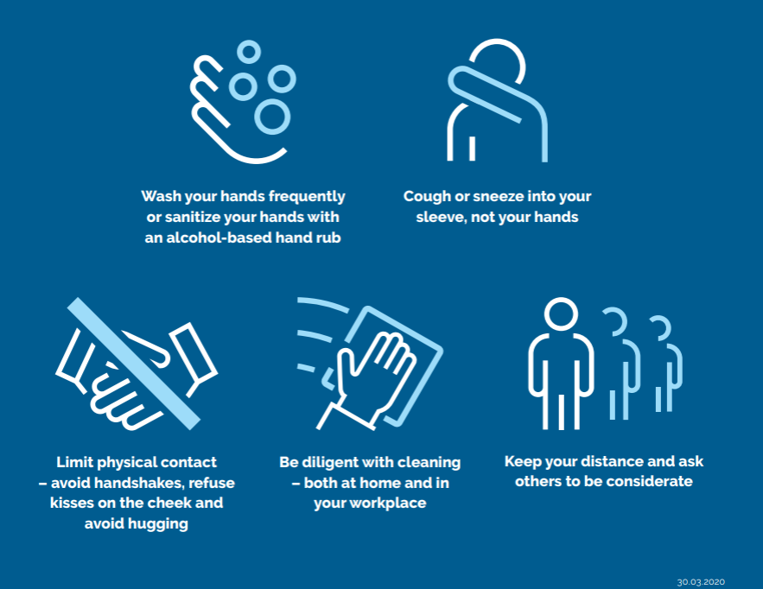
INSTRUCTIONS How we comply with the Danish Health Authority guidelines together Lasse Rosendahl Department of Energy Technology May 29th 2020

Slide 2
Agenda
A bit of background on Covid-19 …
Specific implementation at ET
What has been organized by the department
What is your individual responsibility
Q/A
Opening up now means
Everybody has access as normal with cards on ”weekend-mode”
We don’t maintain weekly schedule for labs

Slide 3
How is COVID-19 transmitted?
The virus that causes COVID-19 is not airborne; it is transmitted through respiratory droplets and contact infection.
Infection via respiratory droplets occurs when small droplets from the airways are spread via uncontrollable coughing and sneezing. Droplets from the airways fall to the ground within 1-2 meters. So with normal activity, we must keep a distance of at least 1 meter.
Infection via respiratory droplets contributes least to the risk of infection, especially in places where people with symptoms are encouraged to stay at home.
Infection via contact is caused by saliva and mucus containing the virus being deposited in the environment and touched by others who then transfer the virus to their face.
The risk of contact infection is reduced through good hand hygiene, contactless solutions, avoiding touching the face, focusing on Joint contact point , etc.
Contact infection contributes most to the risk of infection.

Slide 4
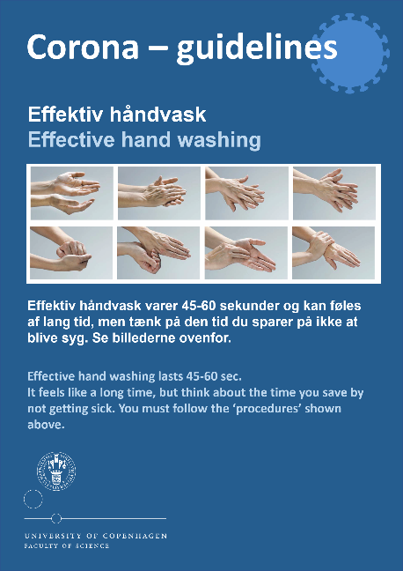
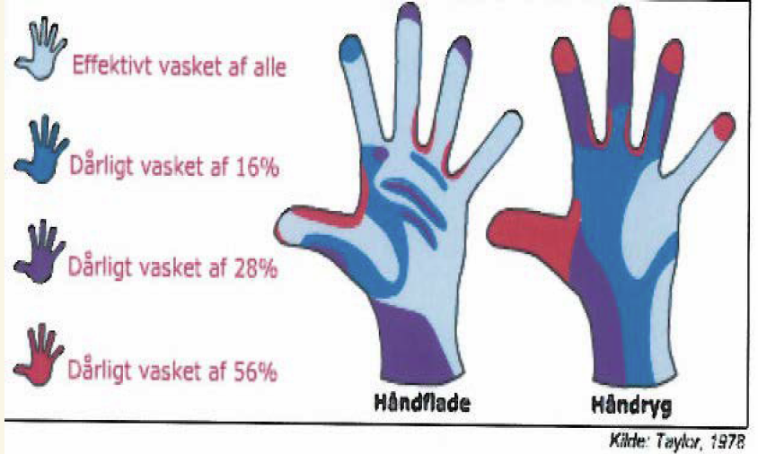
Good hand hygiene
If we always had "clean hands" when we touched things, we would hardly experience contact infection.
Your hands become "unclean" when you have:
Touched your face (eyes, nose, mouth)
Touched a joint contact point (handles, shared equipment...)
Blown your nose, sneezed/coughed into your hands or handkerchief, been
to the toilet, eaten
Given a handshake
To be completely clean, hands must be washed or sanitized properly. If you do it "as usual" and just swish around a little, there are still a lot of viral particles left on your hands.

Slide 5
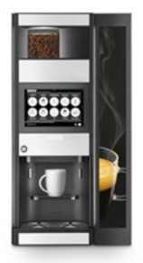
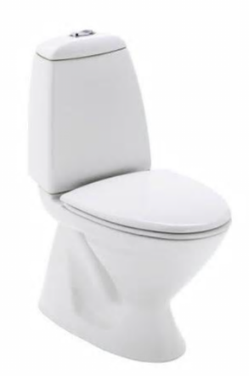
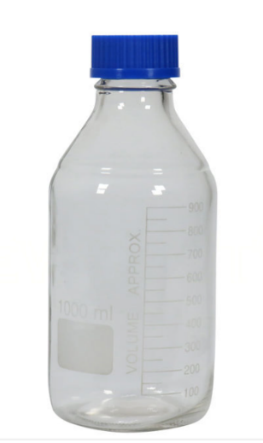
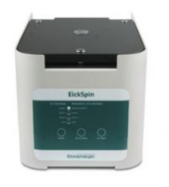
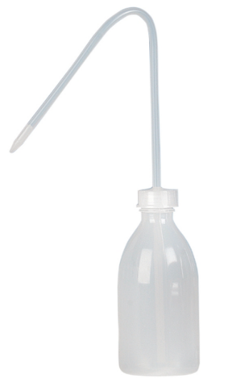
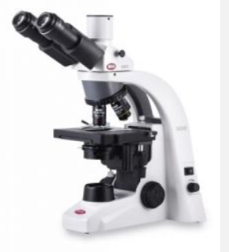
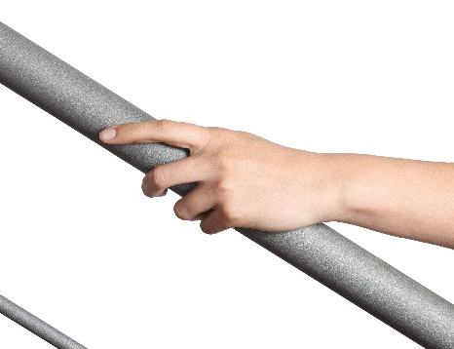
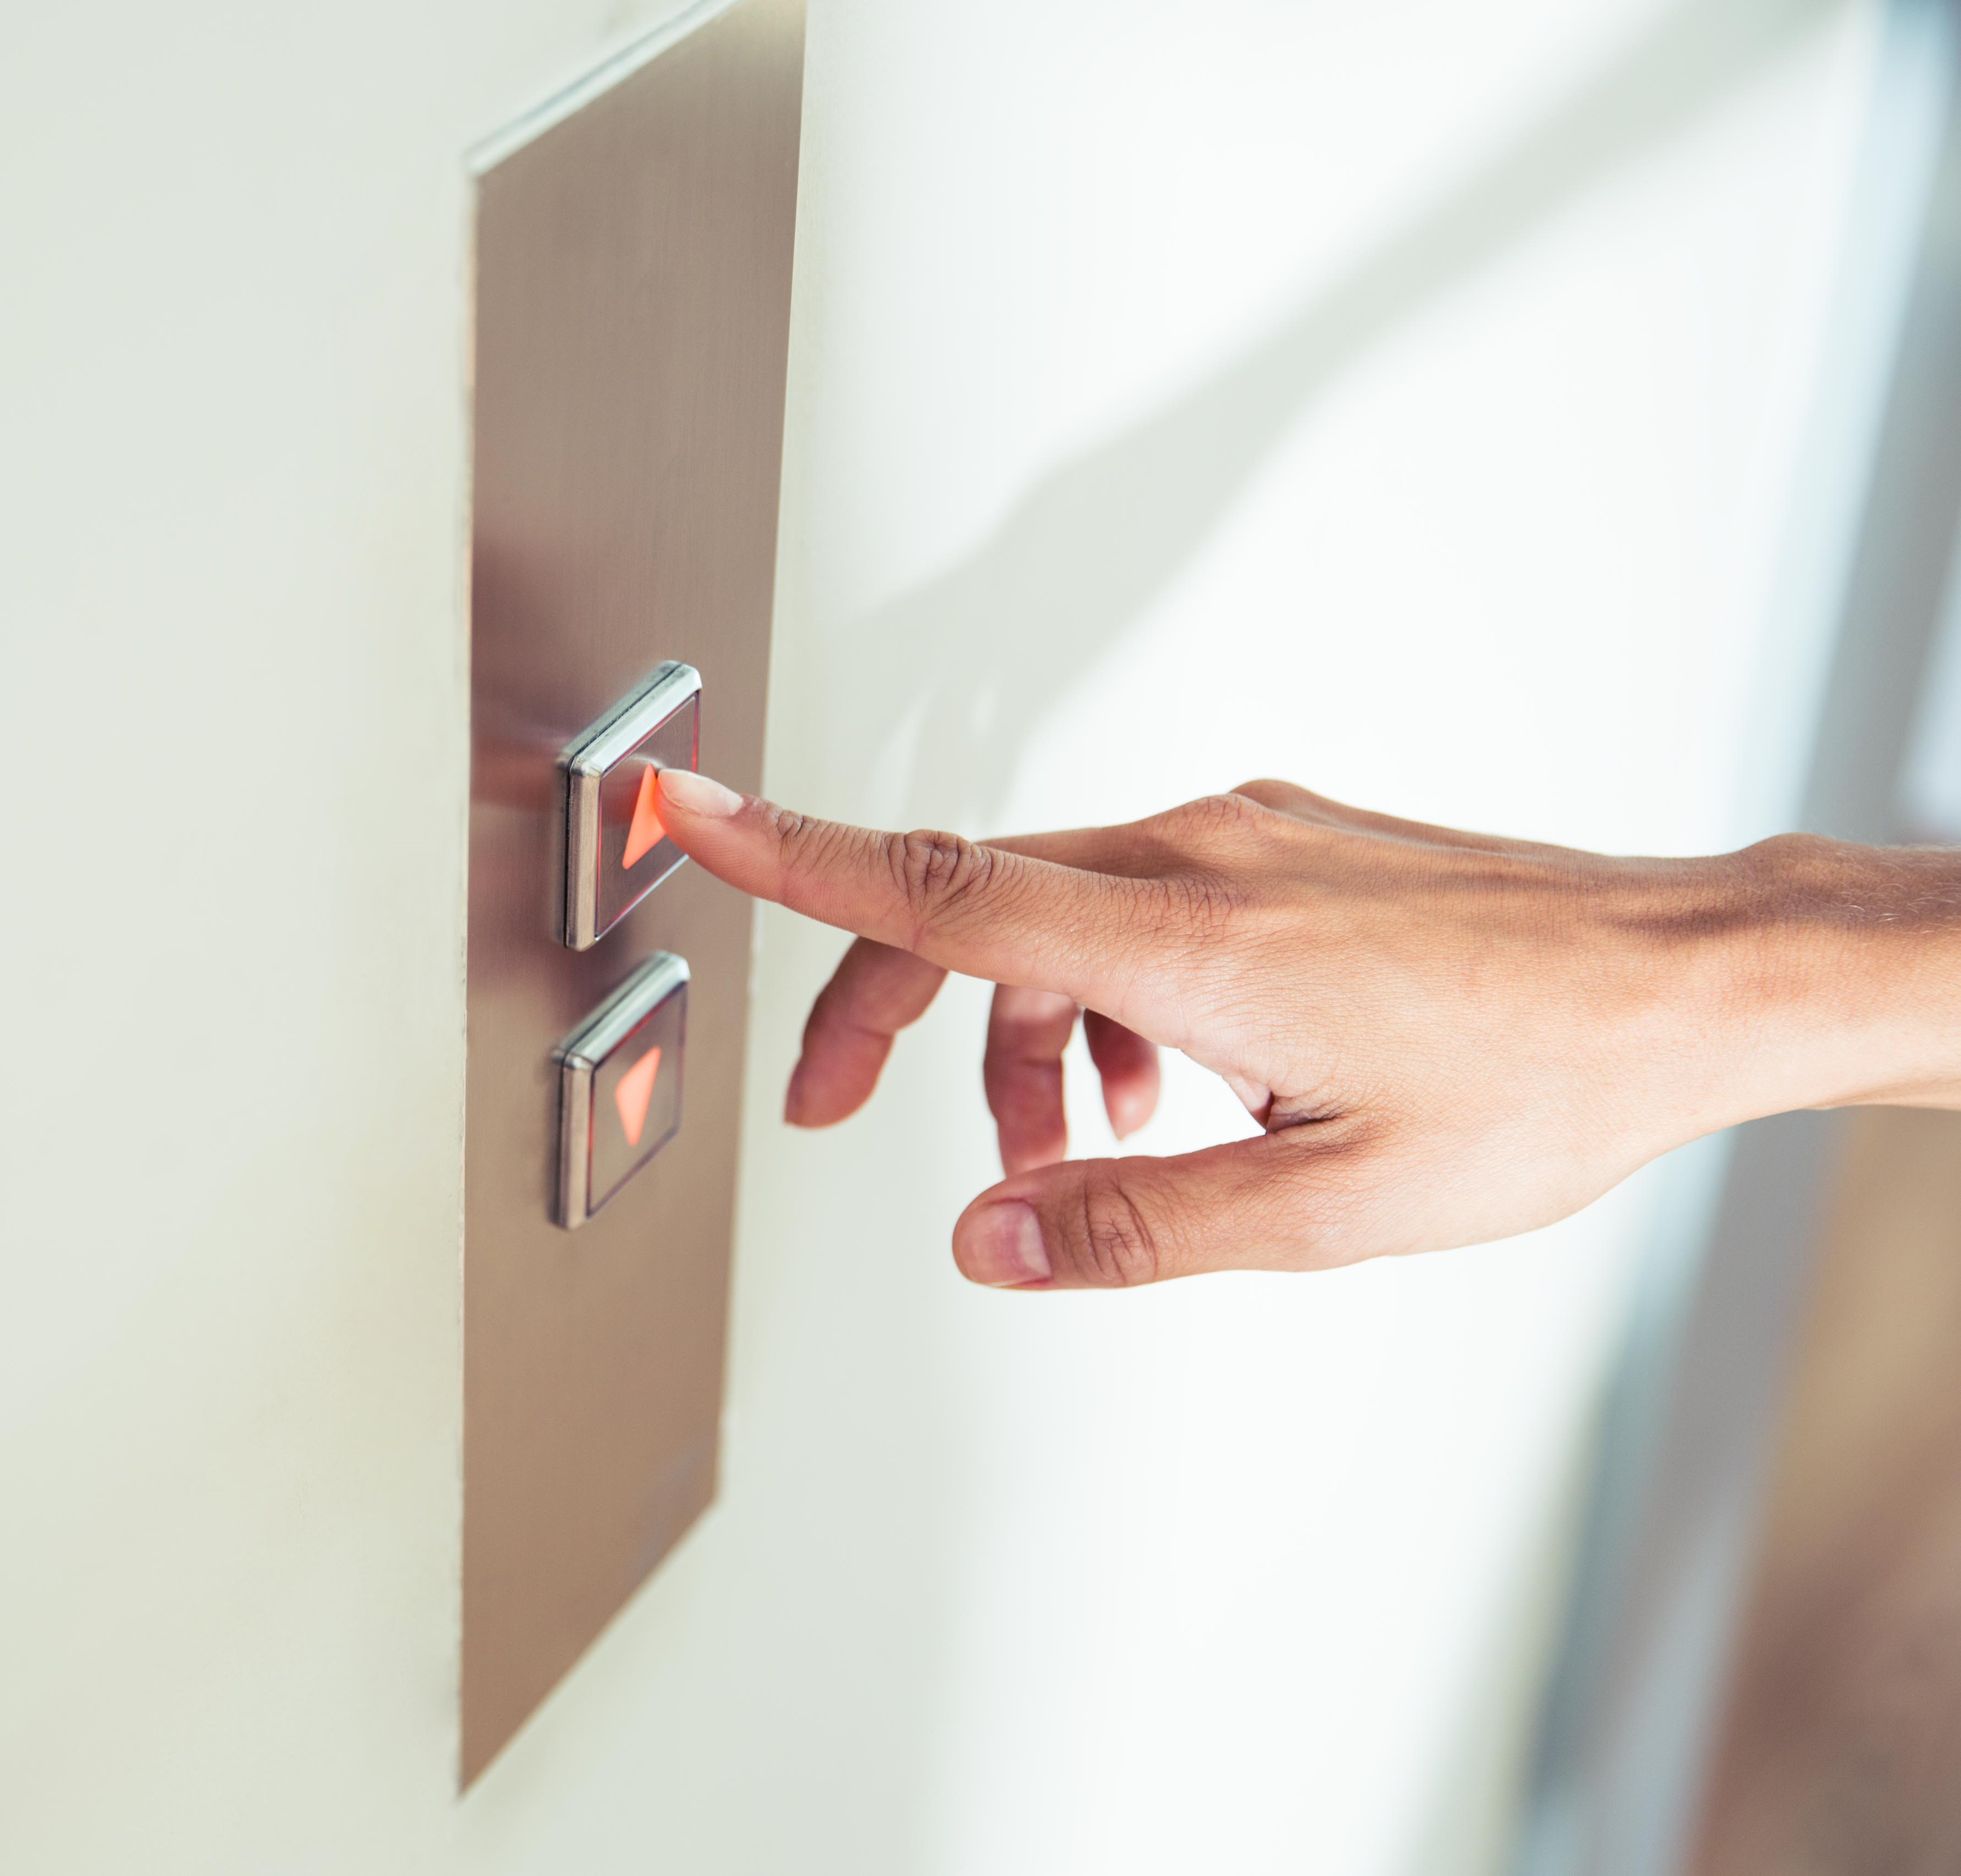
Joint contact point - cleaning and touching
A Joint contact point is a surface touched by a lot of people.
For example, handles, handrails, shared equipment, toilet flush buttons, coffee machines, buttons (e.g. elevator or access control), light switches...
As far as possible, touch Joint contact point with clean hands or clean gloves.
Identify Joint contact point and clean them regularly with water/soap and possibly disinfectant.
Do not use hand sanitizer containing glycerol to disinfect Joint contact point.
Use alcohol, 70-85%.

Slide 6
Habits - avoid touching your face
Infection comes both out of and into facial openings (nose, mouth, eyes). If we didn't touch our face so much, we would avoid a lot of contact infection.
In Sydney, a study was conducted in 2015 by a group of medical students that showed that the 26 students touched their face on average 23 times an hour.
Nearly half of the times - 44 per cent - involved contact with either the eyes, nose or mouth.
Be conscious of when you touch your face and avoid it (especially in public spaces).
Use a tissue if you need to scratch your face.
Make each other aware of it.
Notes:
Link til den australske undersøgelse: https://www.ncbi.nlm.nih.gov/pubmed/24530432

Slide 7
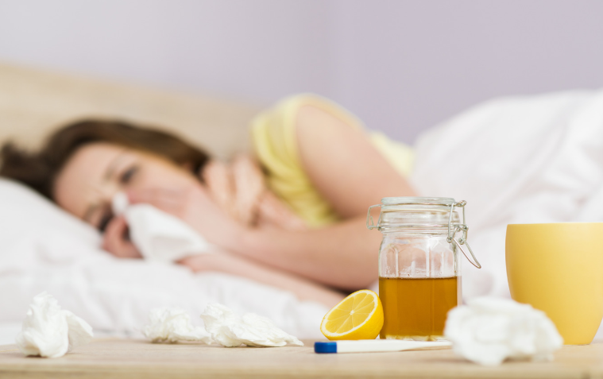
Stay home if you have symptoms
If you have symptoms - even mild symptoms - you should stay home.
You should also stay home if you live in household with a person infected with COVID-19.
Danish Health Authority:
The typical symptoms of onset and mild illness are similar to common symptoms of flu and other upper respiratory infections: sore throat, feeling unwell, muscle pain, dry cough and fever.
Some people may also experience headaches, loss of taste and smell, nausea, diarrhea and possibly other symptoms.

Slide 8
What have we done at ET?
4 basic principles
Keeping our distance: 1 or 2 m, less crowded rooms
Focus on hygiene: hands, common contact points, used service, tidying up
Mutual respect: protect and respect each other by our actions
Common sense …
Mini/Corona-APV
To be sent out next week – 1 week to respond
Concerns experiences with working from home and strictly regulated labs
Very important to have all your feedback and inputs to learn and to start our adjustment towards post-Corona ”normal”

Slide 9
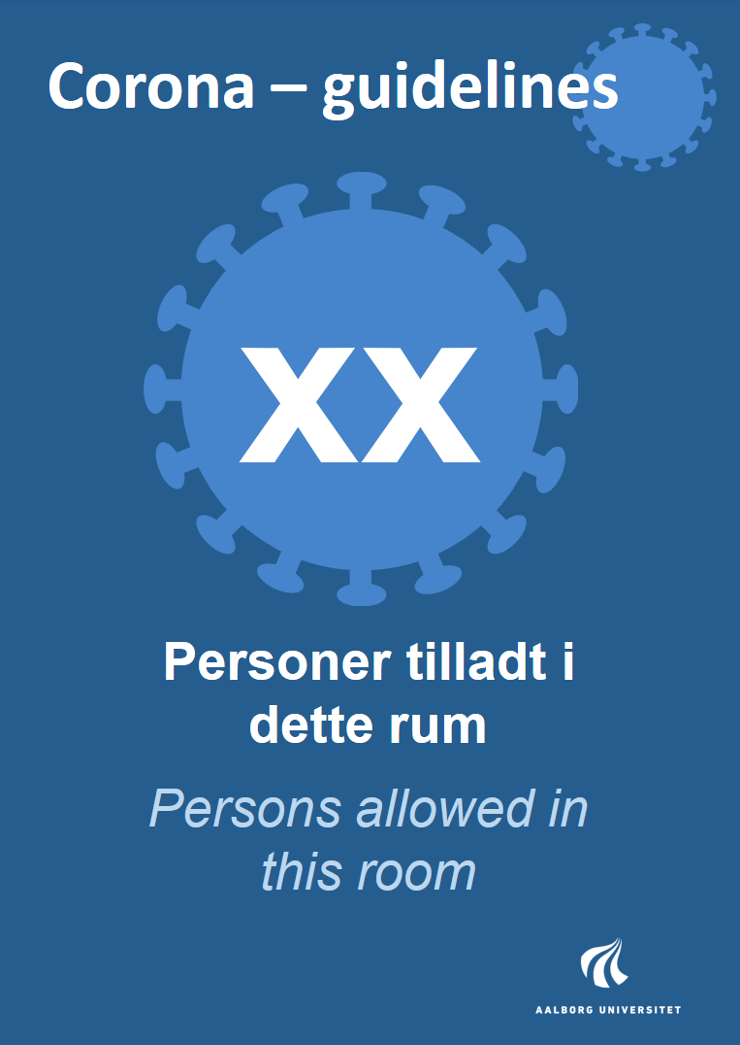
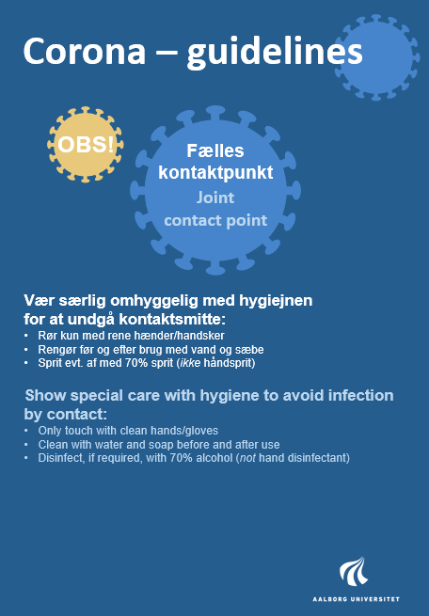
What have we done at ET?
All toilets will be cleaned twice a day
Ethanol, hand sanitizer, wet wipes and/or gloves will be available to everyone at key points (by doors, toilets, common areas, in corridors)
Limits on simultaneous occupants in each room or lab – sign posted on door
Lower occupancy in meeting rooms, coffee rooms
Esbjerg: Staff room in building A closed
Aalborg: significantly reduced capacity in coffee room Pon 111
Lower occupancy in multiple occupant offices – additional space available in student group rooms in Pon 101
2.002, 2.006, 2.008, 2.014, 2.018, 2.022
Limits can be adjusted up or down – to be approved by Safety Committee members
Aalborg: Henrik Sørensen (hs@et.aau.dk) or Christian Winther (cwd@et.aau.dk)
Esbjerg: Jens Bo Holm-Nielsen (jhn@et.aau.dk) or Mette Skjærbæk (msk@et.aau.dk)
Identification of Joint Contact Points

Slide 10
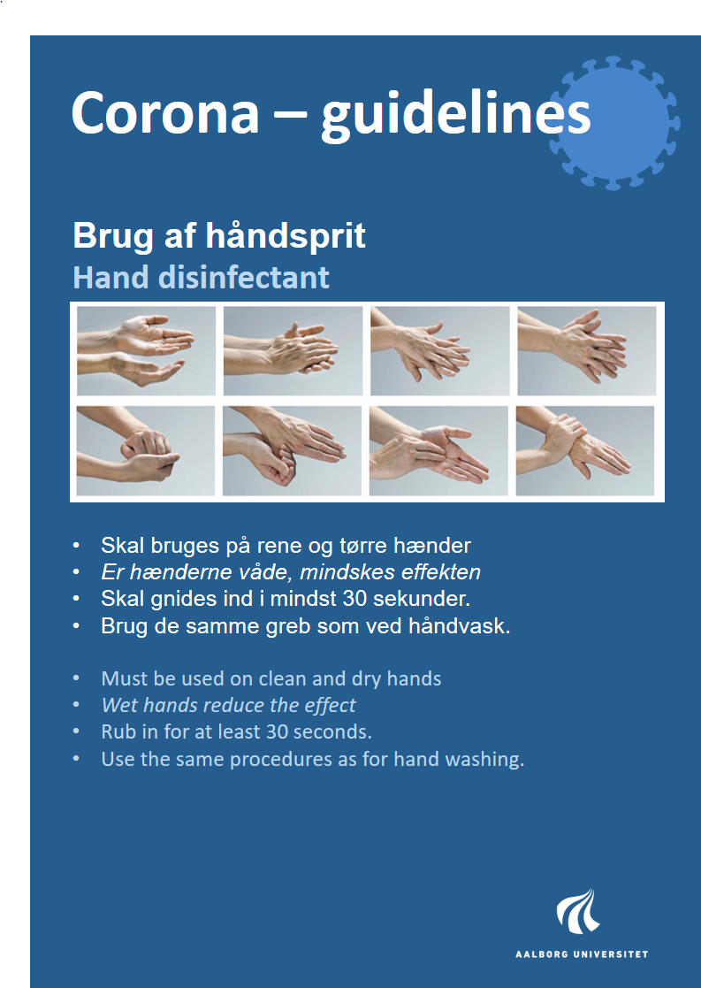
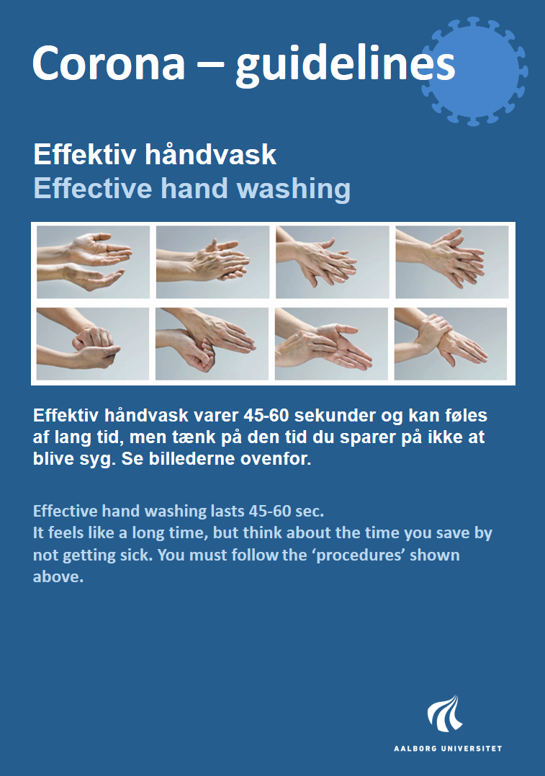
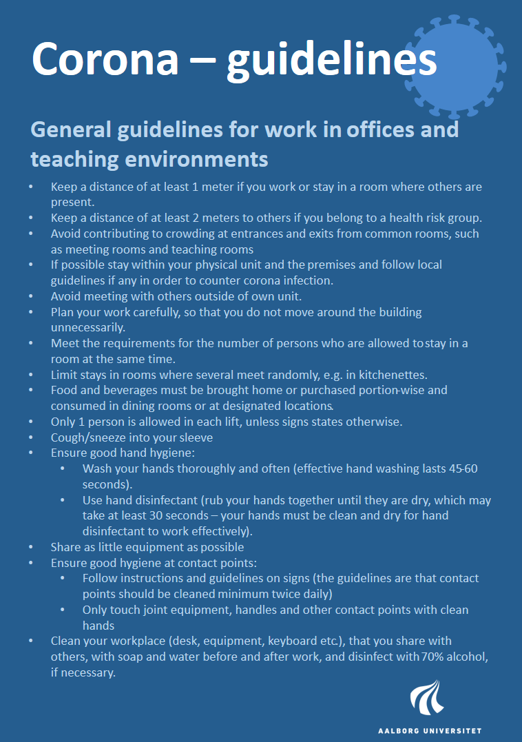
What have we done at ET?
General information posters all over …

Slide 11
What is your INDIVIDUAL responsibility?
Inform you nearest leader if you are in a high risk group – you don’t have to explain why
If you have any reason to believe that you have the virus or have been in contact with someone who has
Get a test asap
Inform your nearest leader
Stay at home
If you have Covid-19, inform your nearest leader and stay at home!
If you are in any way concerned about returning to your work place, inform your nearest leader – we will find a solution…

Slide 12
What is your INDIVIDUAL responsibility?
Maintain high standard of hygiene
wash/sanitize your hands frequently
Clean surfaces and objects you are working on/with frequently
When you leave a work/rest place, eg a lab/dining table, you must clean it so it is safe for the next user
Maintain safe distances - don’t crowd
1 m nose-to-nose is the minimum safe distance
For colleagues in high risk groups, 2 m is the minimum safe distance
If you are in a high risk group, you must inform others to keep this distance
Count the number of occupants in a room before entering to make sure you don’t exceed the limit
Stand aside when passing others in a tight space
Food and drink
You have to bring your own food and drink to work
Canteens in Esbjerg and Aalborg will be open on limited hours
Coffee and hot water will be available as usual
Storage in fridges etc according to high hygienic standards – containerized
You have to put all your used cutlery and chinaware into the dishwasher after use by YOURSELF – otherwise all will be removed
Sanitize your hands before touching fridges, drawers, coffee machines, water dispensers etc

Slide 13
Final statements
Consequences – aside from spreading the virus – of breaches of guidelines could be
Closure of lab or office area – removal of access priviliges
Personal reprimand
Consequences to AAU as an organization
Help each other to stay safe and act according to the regulations
Let others know if you think there is a problem – communicate and resolve
Notify Safety Committee or your nearest leader if it persists
Suggest good ideas and improved practices
In general, use your common sense and help each other to stay safe!

Slide 14
INSTRUCTIONS How we comply with the Danish Health Authority guidelines together Q&A

